Slide 1
The Enhanced Entity-Relationship Model
Since the 1980s there has been an increase in the emergence of new database applications with more demanding requirements.
Basic concepts of ER modeling are not sufficient to represent the requirements of the newer, more complex applications.
Response is development of additional ‘semantic’ modeling concepts.
Semantic concepts are incorporated into the original ER model and is called the Enhanced Entity-Relationship (EER) model.
Additional concepts of EER model includes specialization / generalization, part/whole, and Categorization.

Slide 2
Supertypes and Subtypes
Subtype: A subgrouping of the entities in an entity type that has attributes distinct from those in other subgroupings
Supertype: A generic entity type that has a relationship with one or more subtypes
Attribute Inheritance:
  Subtype entities inherit values of all attributes of the supertype
  An instance of a subtype is also an instance of the supertype

Slide 3
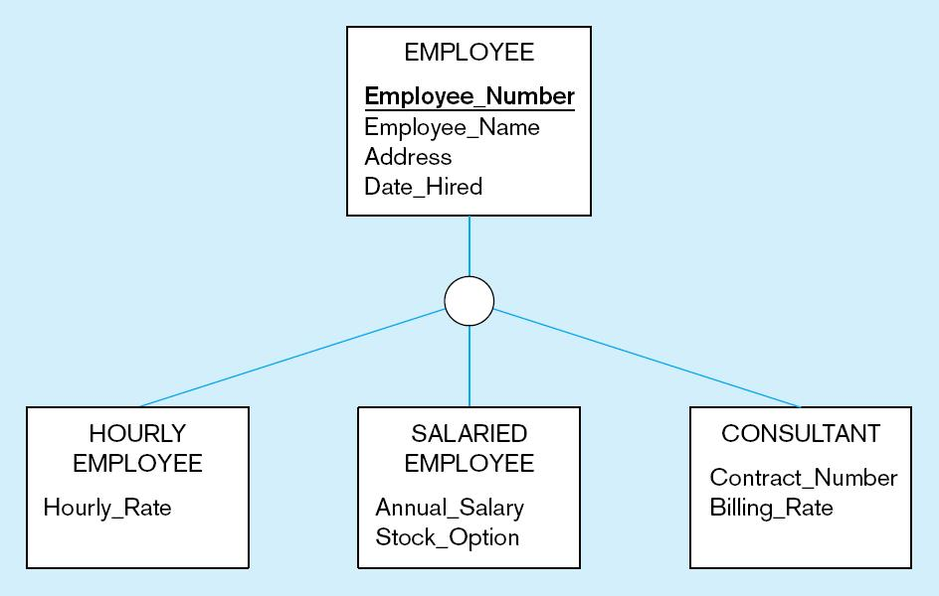
All employee subtypes will have emp nbr, name, address, and date hired
Each employee subtype will also have its own attributes

Slide 4
Relationships and Subtypes
Relationships at the supertype level indicate that all subtypes will participate in the relationship
The instances of a subtype may participate in a relationship unique to that subtype. In this situation, the relationship is shown at the subtype level

Slide 5
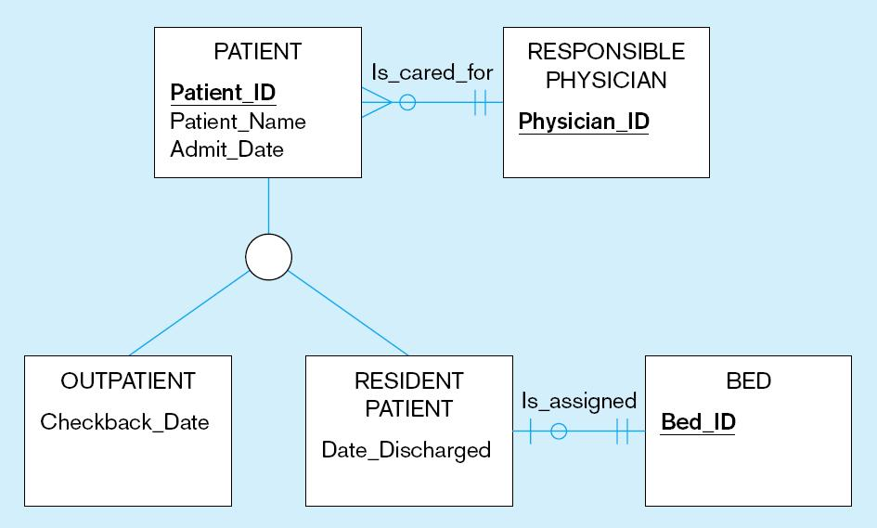
Both outpatients and resident patients are cared for by a responsible physician
Only resident patients are assigned to a bed

Slide 6
Generalization and Specialization
Generalization: The process of defining a more general entity type from a set of more specialized entity types. BOTTOM-UP
Specialization: The process of defining one or more subtypes of the supertype and forming supertype/subtype relationships. TOP-DOWN
Generalization
Aircraft
Specialization
Commercial
Military
747
777
B52
B-1B

Slide 7
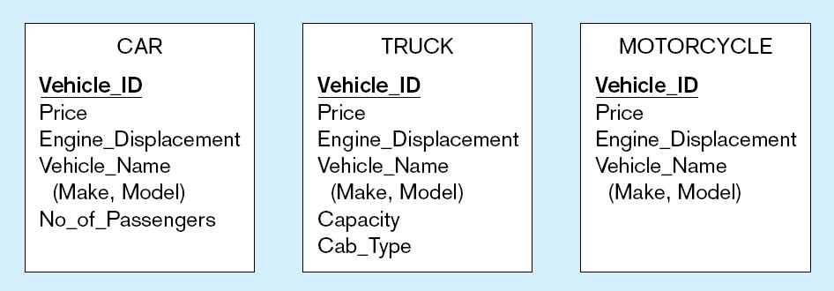
Example of generalization
All these types of vehicles have common attributes

Slide 8
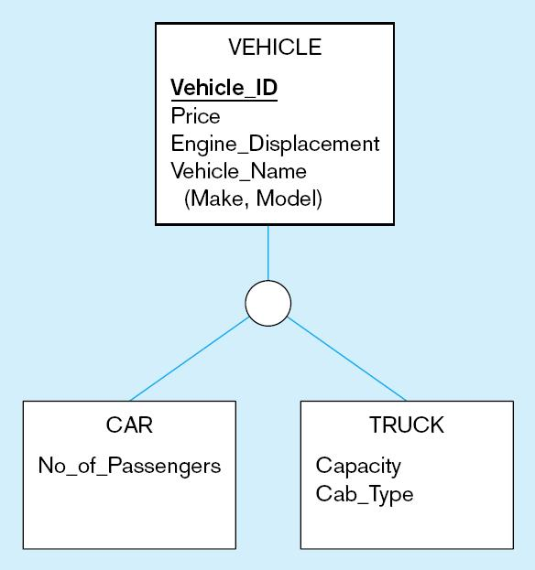
So we put the shared attributes in a supertype
Note: no subtype for motorcycle, since it has no unique attributes

Slide 9
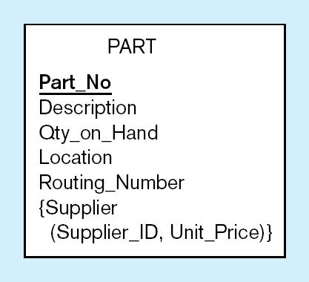
Example of specialization
Only applies to manufactured parts
Applies only to purchased parts

Slide 10
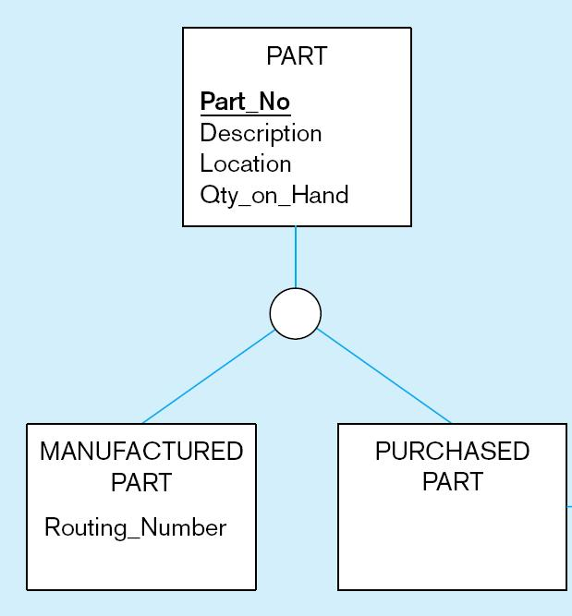
Created 2 subtypes

Slide 11
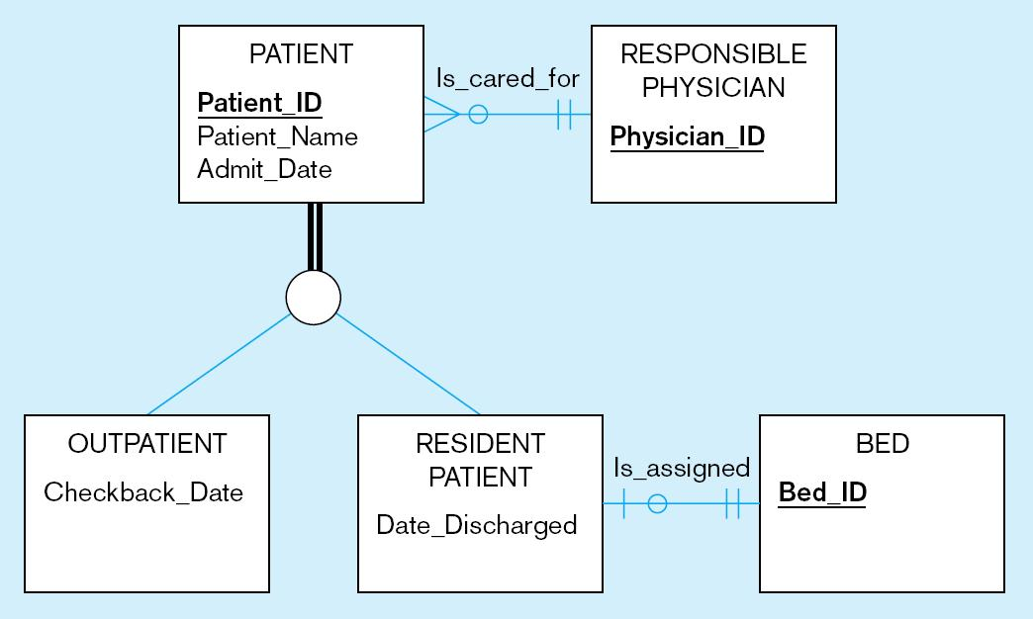
Completeness Constraint
Whether an instance of a supertype must also be a member of at least one subtype
  1.Total Specialization Rule: Yes (double line)
A patient must be either an outpatient or a resident patient

Slide 12
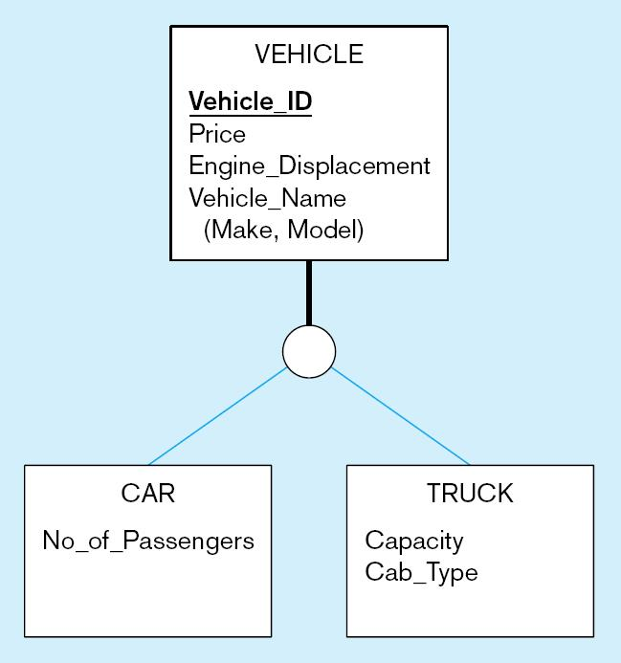
  2. Partial Specialization Rule: No (single line)
A vehicle could be a car, a truck, or neither

Slide 13
Disjointness constraint
Whether an instance of a supertype may simultaneously be a member of two (or more) subtypes
  Disjoint Rule: An instance of the supertype can be only ONE of the subtypes
  Overlap Rule: An instance of the supertype could be MORE THAN ONE of the subtypes

Slide 14
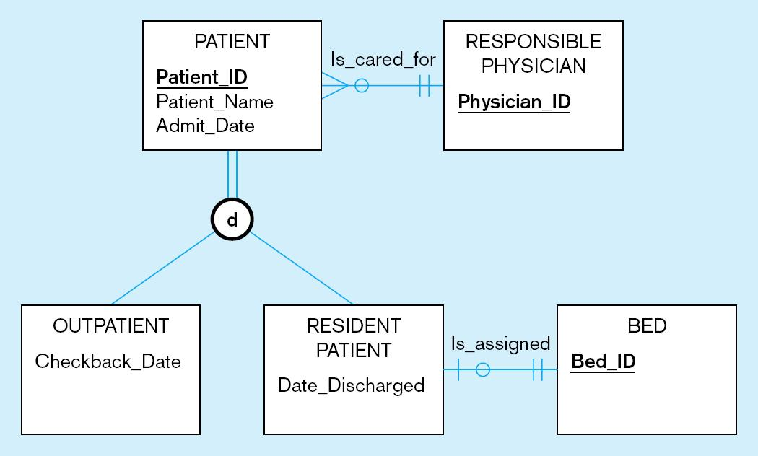
Disjoint rule - indicate d on the circle
A patient can either be outpatient or resident, but not both

Slide 15
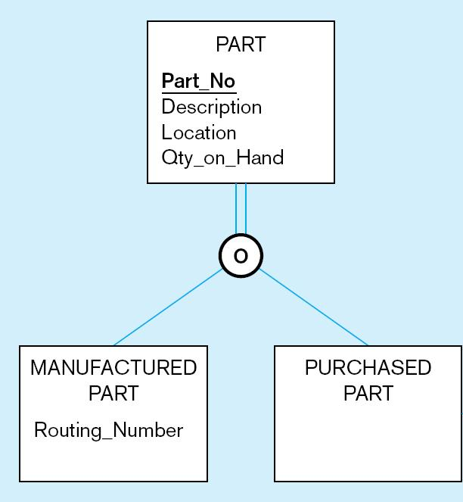
Overlap rule - indicate o on the circle
A part may be both purchased and manufactured

Slide 16
Disjointness Discriminators
An attribute of the supertype should have values that determine the target subtype(s)
  Disjoint – a simple attribute with alternative values to indicate the possible subtypes
  Overlapping – a composite attribute whose subparts pertain to different subtypes. Each subpart contains a boolean value to indicate whether or not the instance belongs to the associated subtype

Slide 17
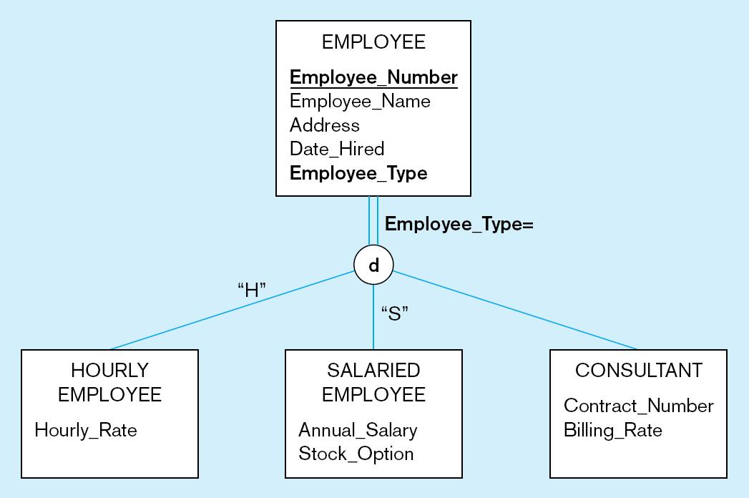
disjoint rule
A simple attribute with different possible values indicating the subtype

Slide 18
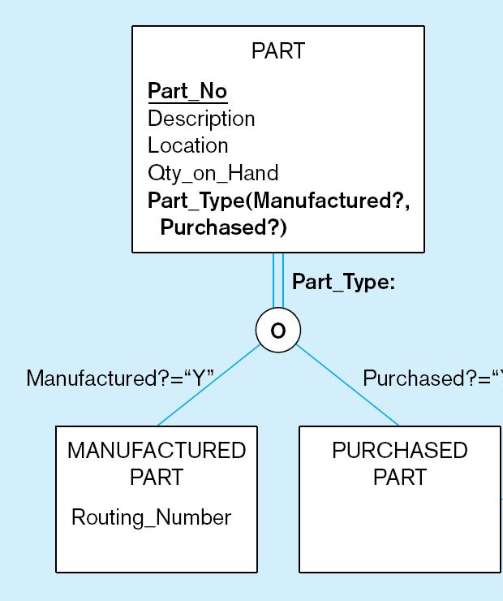
overlap rule
A composite attribute with values indicating “yes” or/and “no” to determine whether it is of each subtype
Y”

Slide 19
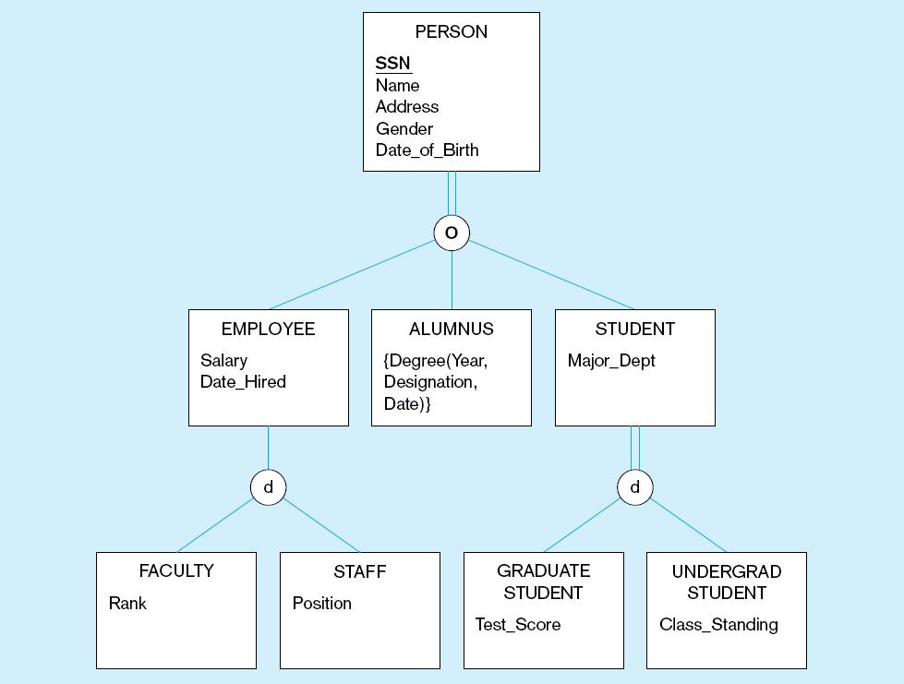
Example of EER diagram

Slide 20
Entity Clusters
EER diagrams are difficult to read when there are too many entities and relationships
Solution: Group entities and relationships into entity clusters
Entity cluster: Set of one or more entity types and associated relationships grouped into a single abstract entity type

Slide 21
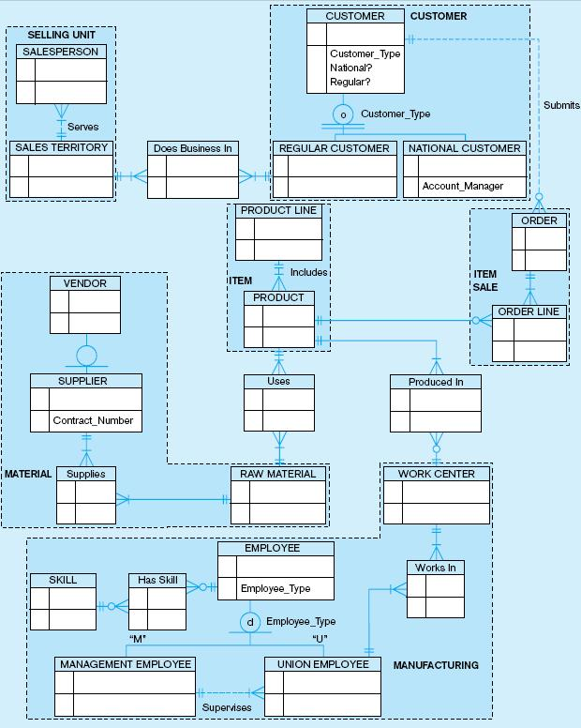
Related groups of entities could become clusters

Slide 22
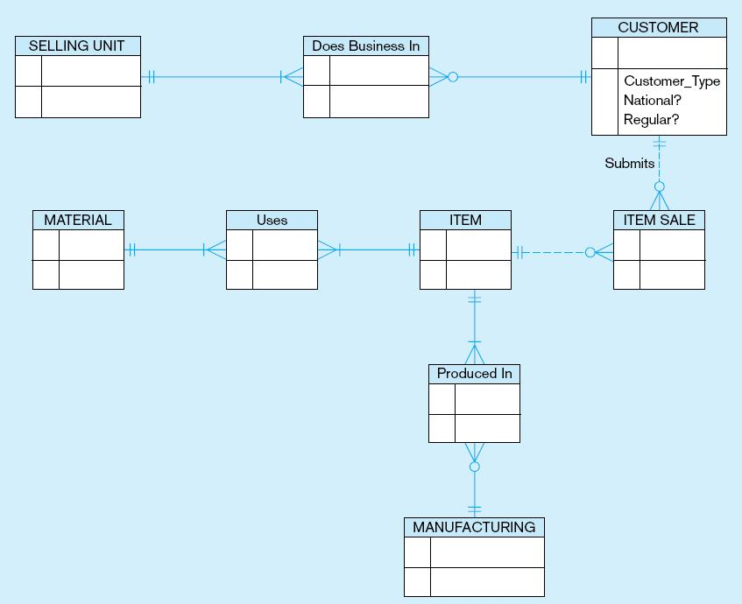
EER diagram with entity clusters only
More readable, isn’t it?

Slide 23
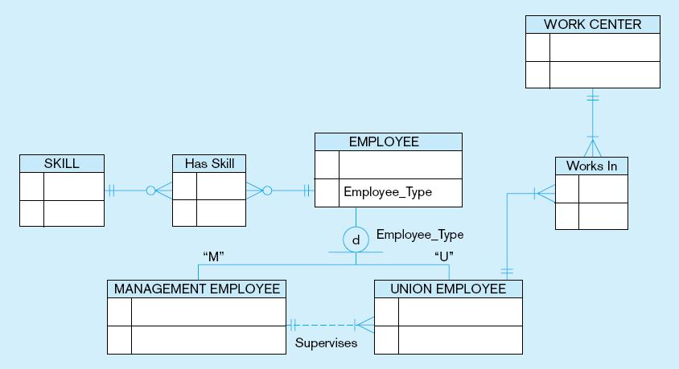
Manufacturing entity cluster
Detail for a single cluster

